Slide 1
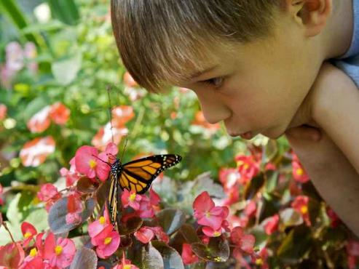
22nd-28th August 2021

Slide 2
Call to worship
Listen! There is an invitation for you to open this morning,
The one who loves us is seeking our heart.
The breezes are whispering it;
The sunrise announces it;
The earth trembles with the energy of it:
Let us be still and quiet so we may hear,
and hearing, let delight overcome our caution;
let our hearts resonate with the joy of God’s call.

Slide 3
The call to receive love,
the call to offer love,
the call to know grace,
the call to show grace.
There is an invitation for us to open this morning –
We are here, we are listening.

Slide 4
Scripture reading
18 At that time the disciples came to Jesus and asked, ‘Who is the greatest in the kingdom of heaven?’ ² He called a child, whom he put among them, ³ and said, ‘Truly I tell you, unless you change and become like children, you will never enter the kingdom of heaven. ⁴ Whoever becomes humble like this child is the greatest in the kingdom of heaven.
⁵ Whoever welcomes one such child in my name welcomes me.
MATTHEW 18: 1-5

Slide 5
Conversation starters
in small groups, brainstorm together the childlike qualities that you think might help to make us good disciples – Jesus mentions humility in this scripture, but what other qualities do you associate with childlikeness? You might like to feed these qualities back into the large group before moving on to the next piece.

Slide 6
Conversation starters
then consider together: how might these qualities help us follow Jesus and be participants in the work of the Kingdom of Heaven? What difference might it make if we were more willing and able to embrace humility, for example? Another opportunity for large group feedback here if you want.
take turns telling a story from your childhood where you remember living out any one of the qualities you have come up with in your brainstorm – what was that like and why do you remember that story, do you think?

Slide 7
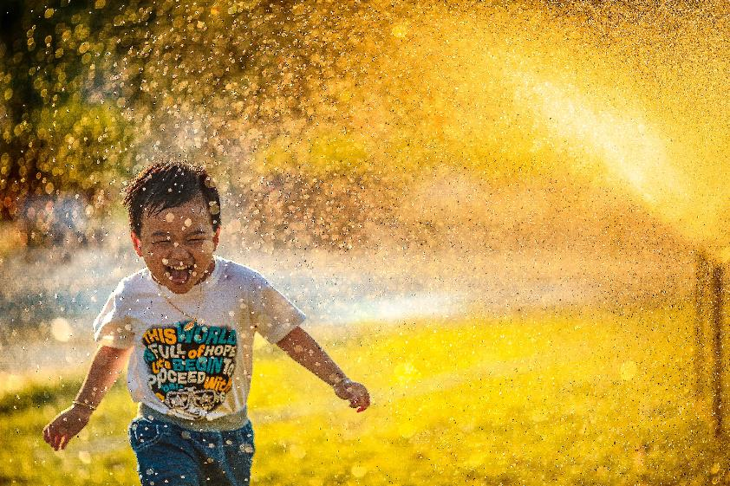
Remembering.... wonder
Conversation starters
In small groups, brainstorm together the childlike qualities that you think might help to make us good disciples – Jesus mentions humility in this scripture, but what other qualities do you associate with childlikeness?

Slide 8
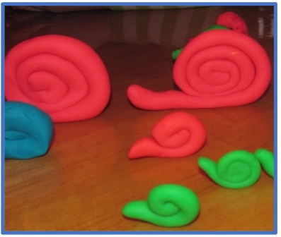
Snail activity for all ages
Invite everyone to respond to the Word by making a play-dough snail.
This snail will be a companion and guide as we begin the week in wonder and explore child-like characteristics throughout this ‘Praying for Children’ week.

Slide 9
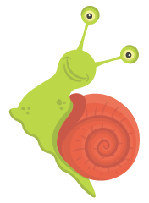
Albert Einstein
“The most beautiful experience we can have is of the mysterious. The person to whom this emotion is a stranger, who can no longer pause to wonder and stand rapt in awe, is as good as dead.”

Slide 10
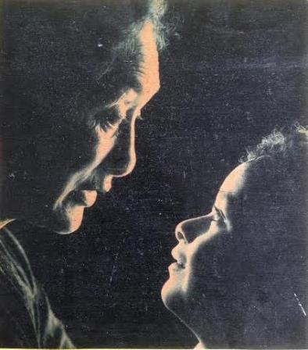
Remembering.... giving attention
Practising giving attention
Find a quiet spot outside, in your garden, on your doorstep, on a park bench, or even inside your home looking outside.
Sit there quietly for ten minutes and give careful attention to what is around you.

Slide 11
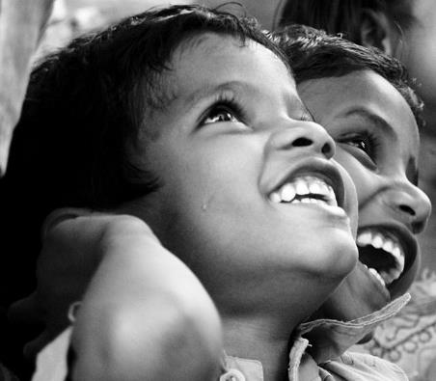
Remembering.... innocence
You have accepted Christ Jesus as your Lord. Now keep on following him. Plant your roots in Christ and let him be the foundation for your life. Be strong in your faith, just as you were taught. And be grateful.
Colossians 2:6-7 CEV

Slide 12
Remembering.... curiosity
Practising Curiosity
Take a ten minute walk around your neighbourhood sometime today.
Put on the eyes of a child as though you are seeing things for the first time.
What makes you curious?

Slide 13
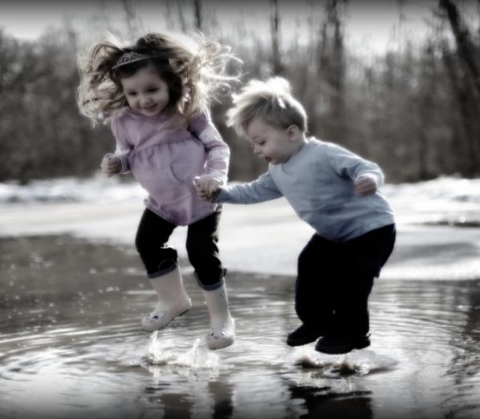
Remembering.... playfulness
Where are you playful in your life today?
Who are you free to be silly with?
How do you practice playfulness in your life today?

Slide 14
Remembering... ongoing questions
Practising asking the questions
Sit and make a list of ten questions you have about the world. What have you always wondered about…about science, about technology, about the environment, about your body, about God.

Slide 15
Remembering.... trust
Practising trust
Make a list of the people you most trust. Those who love you just because you are you.
Make another list of the people who most trust you...those whom you love just because they are who they are.
Give thanks for those who you trust and for those who trust you.

Slide 16
Praying for Children Karaka mo ngā tamariki
Take a bookmark!
Commit to reading the printed prayer
and different phrase each day
to guide your prayer and action.
For a daily story, resources and more ideas go to:
https://resourcingprayerandworship.wordpress.com/

Slide 17
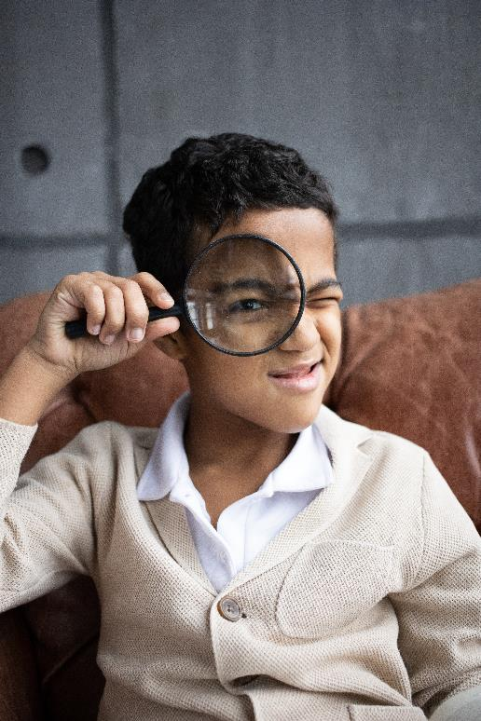
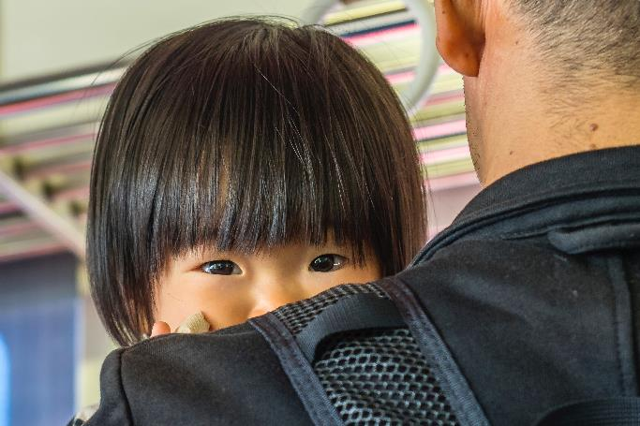
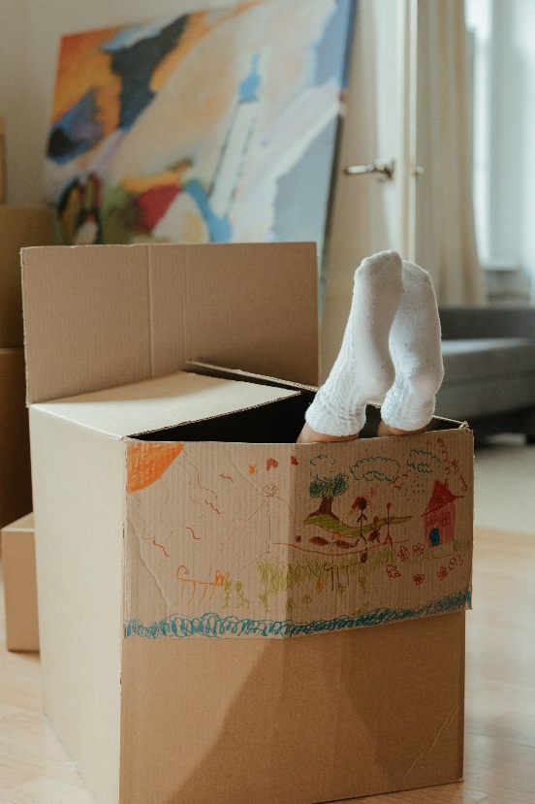
Praying for Children Karaka mo ngā tamariki
https://resourcingprayerandworship.wordpress.com/

